Slide 1


2023 Nonprofit &
Public Sector
Seminar

Slide 2
GASB Update
Public Sector
Jacob Holman, CPA / May 2023

Slide 3
Effective Dates
Final Standards and Implementation Guides
Current Projects and Research

Slide 4
Effective Dates – June/September 30
2023
2024
2025
91 Conduit debt
94 P3s
96 SBITA
98 ACFR
99 Omnibus 2022 (partial)
IG 2020-1 (partial)
IG 2021-1 (partial)
99 Omnibus 2022 (partial)
IG 2021-1 (partial)
100 Accounting changes and error corrections
101 Compensated absences

Slide 5
Effective Dates – December 31
2023
2024
94 P3s
96 SBITA
99 Omnibus 2022 (partial)
IG 2021-1 (partial)
99 Omnibus 2022 (partial)
100 Accounting changes and error corrections
101 Compensated absences
IG 2021-1 (partial)

Slide 6
Final Standards
Statement No. 91, Conduit Debt Obligations
Statement No. 94, Public-Private and Public-Public Partnerships and Availability Payment Arrangements
Statement No. 96, Subscription-Based Information Technology Arrangements
Statement No. 99, Omnibus 2022
Statement No. 100, Accounting Changes and Error Corrections
Statement No. 101, Compensated Absences

Slide 7
Statement No. 91, Conduit Debt Obligations

Slide 8
Definition of Conduit Debt
There are at least three parties involved: the government-issuer, the third-party obligor (borrower), and the debt holder or trustee.
The issuer and the third-party obligor are not within the same financial reporting entity.
The debt obligation is not a parity bond of the issuer, nor is it cross-collateralized with other debt of the issuer.
The third-party obligor or its agent, not the issuer, ultimately receives the proceeds from the debt issuance.
The third-party obligor, not the issuer, is primarily obligated for the payment of all amounts associated with the debt obligation.

Slide 9
Limited, Additional & Voluntary Commitments Extended by Issuers
Generally, issuers’ commitments are limited to the resources provided by the third-party obligor.
Occasionally, an issuer may extend an
additional commitment
to support debt service in the event of the third-party obligor’s default.
For example:
Extending an appropriation pledge
Extending a financial guarantee
Pledging its own property, revenue, or other assets as security
Extending a moral obligation pledge
Under a voluntary commitment, issuer voluntarily decides to make a debt service payment or request an appropriation for a payment in the event that the third-party is, or will be, unable to pay.

Slide 10
Recognition by the Issuer
Do not recognize a conduit debt obligation as a liability
May have a related liability arising out of an additional or voluntary commitment
Additional commitment: report a liability when qualitative factors indicate it is more likely than not that the issuer will support debt service payments for a conduit debt obligation
Voluntary commitment: if a certain event or circumstance has occurred, evaluate likelihood, then report a liability if it is more likely than not that the issuer will support debt service payments
Voluntary commitments for which a liability is recognized and all additional commitments: At least annually reevaluate whether recognition criteria are met while conduit debt is outstanding
Notes:
Box 3: The list of qualitative factors in paragraph 13 should be used to assess whether it is more likely than not an issuer will support debt service payments.

Slide 11
Arrangements and Capital Assets
Some conduit debt obligations include
arrangements* that involve capital assets to be used by the third-party obligor but owned by the issuer.
Payment schedule of the arrangement coincides with the debt service repayment schedule.
Capital asset is built or acquired with proceeds of the conduit debt obligation.
Payments from the third-party obligor are to cover debt service payments.
Issuer retains title to the capital asset from the beginning of the arrangement.
*Often characterized as “leases”

Slide 12
Arrangements and Capital Assets (continued)
Accounting by the issuer:
Do not report those arrangements as leases
Do not recognize a liability for the related conduit debt obligations
Do not recognize a receivable for the payments related to those arrangements
If the arrangement meets the definition of a service concession arrangement, follow Statement 60

Slide 13
Arrangements and Capital Assets (continued)
Does title pass to third-party obligor at end of arrangement? | Does the issuer recognize a capital asset? | Does the issuer recognize a deferred inflow of resources?
Yes | No | No
No, and third party has exclusive use of entire capital asset | Yes, when the arrangement ends | No
No, and third party has exclusive use of only portions of the capital asset | Yes, at the inception of the arrangement | Yes, at the inception of the arrangement; deferred inflow recognized as revenue over the term of the arrangement

Slide 14
Disclosures by Type of Commitment
A general description of the issuer’s conduit debt obligations
Description of limited commitments
If the issuer recognizes a related liability
Description of timing of recognition and measurement of the liability
Cumulative payments that have been made
Amounts expected to be recovered, if any, for those payments
Description of additional commitments (legal authority and limits; length; arrangements for recovering payments from third-party obligors, if any)
Aggregate outstanding principal amount
Beginning balances, increases, decreases, ending balances

Slide 15
Statement No. 96, Subscription-Based Information Technology Arrangements

Slide 16
Scope and Applicability
A subscription-based information technology arrangement (SBITA) “is a contract that conveys control of the right to use another party’s (a SBITA vendor’s) IT software, alone or in combination with tangible capital assets (the underlying IT assets) as specified in the contract for a period of time in an exchange or exchange-like transaction.”
To determine whether a contract conveys control of the right to use the underlying IT assets, a government should assess whether it has both:
The right to obtain the present service capacity from use of the underlying IT assets as specified in the contract
The right to determine the nature and manner of use of the underlying IT assets as specified in the contract.

Slide 17
Scope and Applicability (continued)
Statement 96 does not apply to:
  Contracts that convey control of the right to use another party’s combination of IT software and tangible capital assets that meets the definition of a lease in Statement 87, in which the software component is insignificant compared to the cost of the underlying tangible capital asset
  Governments that provide the right to use their IT software and associated tangible capital assets to other entities through SBITAs
  Contracts that meet the definition of a P3 in Statement 94
  Licensing arrangements that provide a perpetual license to governments to use a vendor’s computer software, which are subject to Statement 51

Slide 18
Relationship between Leases and SBITAs
All SBITAs meet definition of lease
Depends on what the underlying asset is:
  Tangible capital assets alone – Statement 87
  IT software alone – Statement 96
  IT software in combination with tangible capital assets:
    Software component is insignificant compared to cost of underlying tangible capital asset – Statement 87
    Otherwise – Statement 96

Slide 19
Recognition and Measurement
An SBITA should be reported under provisions effectively the same as those for a lessee under Statement 87—recognize a subscription asset and a subscription liability (except for short-term SBITAs)
Measurement of the subscription asset should include certain capitalizable implementation costs based on stages similar to those for internally developed software in Statement 51:
Preliminary project stage
Initial implementation stage
Operation and additional implementation stage

Slide 20
Accounting for Activities Associated with a SBITA
Preliminary project stage
Outlays should be expensed as incurred
Initial implementation stage
In general, outlays should be capitalized
However, if no subscription asset is recognized (such as for a short-term SBITA), outlays should be expensed as incurred
Operation & additional implementation stage
Outlays in this stage should be expensed as incurred unless they meet specific capitalization criteria

Slide 21
Statement No. 99, Omnibus 2022

Slide 22
General Omnibus Topics
Financial Guarantees
Extended Use of LIBOR
Technical Updates/Corrections
Leases, PPPs, and SBITAs
Other Derivative Instruments

Slide 23
Financial Guarantees
Statement 99 DOES
Apply the liability recognition, liability measurement, and disclosure requirements in Statement 70 to governments that extend exchange or exchange-like financial guarantees.
Statement 99 DOES NOT
Prescribe expense classification.
Prescribe recognition guidance for the consideration received in an exchange or exchange-like financial guarantee transaction.

Slide 24
Other Derivative Instruments
Other Derivative Instruments
Change in fair value would be reported on flow statement separately from investment revenues
Termination of hedge accounting
If hedging derivative instruments cease to be effective, the balance of the deferrals would be reported on the flows statement separately from investment revenues.
Disclosures would be distinguished from hedging derivative instruments and investment derivative instruments
Disclose fair value of derivative instruments that were reclassified from hedging derivative instruments

Slide 25
Leases, PPPs, and SBITAs
Remeasurement of certain assets and liabilities
Would not be remeasured solely for a change in an index or rate used to determine variable payments
Option to Terminate
Unconditional right that exists within the contract - the right to terminate due to the action or inaction of the other party is not an option to terminate
Short-term Leases and SBITAs
Modified short-term leases or SBITAs would be remeasured from the inception of the lease or SBITA
For leases only - the option to purchase the underlying asset would be considered an option to terminate for purposes of measuring the lease term

Slide 26
Leases, PPPs, and SBITAs (cont.)
Variable Lease Payments
Variable lease payments, other than those that depend on an index or rate or those that are fixed in substance, would not be included in the measurement of the lease liability.
Lease Incentives
Includes the assumption of or an agreement to pay a lessee’s preexisting lease obligation to a third party
The receivable for the underlying PPP asset would be remeasured if there is a change in the PPP term
PPP Remeasurement
Deferred outflow of resources would be adjusted by the same amount as any remeasurement change to the liability for the underlying PPP asset

Slide 27
Replacement of Interbank Offered Rates
London Interbank Offered Rate (LIBOR)
Date at which it is not an appropriate benchmark interest rate would change to when it is no longer determined by the ICE Benchmark Administration using the methodology in place as of December 31, 2021.

Slide 28
Technical Updates/Corrections
SNAP/ Food Stamps
States no longer use paper food stamp coupons. Specialized guidance in Statement 24 is no longer relevant. Should apply Statement 33 instead.
Nonmonetary Transactions
Should disclose measurement attribute(s), rather than basis of accounting for assets transferred.
Pledges of Future Revenue
Blending guidance provided

Slide 29
Technical Updates/Corrections (cont.)
Government-Wide Statements
Clarifies that no total column is required for the financial reporting entity as a whole.
Terminology Updates
Balance sheet – Statement of net position
Balance sheet date – Date of financial statements or Statement of net position date
Equity Funds – Other assets used
Fund Equity – Equity interest
Flow of resources statement – Resource flows statement

Slide 30
Statement No. 100, Accounting Changes and Error Corrections

Slide 31
Classification
Accounting changes
Change in accounting principle
Change in accounting estimate
Change to or within the financial reporting entity
Correction of an error in previously issued financial statements

Slide 32
Change in Accounting Principle
A change in accounting principle results from either:
A change from one generally accepted accounting principle to another that is justified on the basis that the newly adopted accounting principle is preferable, based on the qualitative characteristics of financial reporting
Implementation of new pronouncements

Slide 33
Accounting Estimates
Accounting estimates are:
Outputs determined based on inputs such as data, assumptions, and measurement methodologies
Amounts subject to measurement uncertainty that are recognized or disclosed in basic financial statements

Slide 34
Change in Accounting Estimate
A change in accounting estimate occurs when inputs change
A change in measurement methodology should be justified on the basis that the new methodology is preferable, based on the qualitative characteristics of financial reporting
Changes to inputs result from a change in circumstance, new information, or more experience

Slide 35
Change to or within the Financial Reporting Entity
A change to or within the financial reporting entity results from:
Addition/removal of a fund that results from movement of continuing operations within the primary government, including its blended component units
A change in the fund presentation as major or nonmajor
Addition/removal of a component unit (except for acquisitions, mergers, and transfers of operations, and Statement 90 component units)
Change in presentation (blended or discrete) of a component unit
Notes:
NOTE: Transactions or other events that could be classified as either a change in accounting principle in accordance with paragraph 5a or a change to or within the financial reporting entity should be considered a change to or within the financial reporting entity.

Slide 36
Correction of an Error
An error results from mathematical mistakes, mistakes in the application of accounting principles, or oversight or misuse of facts that existed at the time the financial statements were issued about conditions that existed as of the financial statement date
Facts that existed at the time the financial statements were issued are those that could reasonably be expected to have been obtained and taken into account at that time about conditions that existed as of the financial statement date
A change from (a) applying an accounting principle that is not generally accepted to transactions or other events to (b) applying a generally accepted accounting principle is an error correction
Notes:
NOTE: Transactions or other events that could be classified as either a change in accounting principle in accordance with paragraph 5a or a change to or within the financial reporting entity should be considered a change to or within the financial reporting entity.

Slide 37
Accounting for Accounting Changes and Error Corrections
Change in accounting principle
Reported retroactively by restating prior periods presented, if practicable
Change in accounting estimate
Reported prospectively
Recognized in current-period flows
Change to/within the reporting entity
Reported by adjusting current period beginning balances
Error correction
Reported retroactively by restating prior periods presented
If not practicable, restate beginning balances of current period

Slide 38
Display
Aggregate amount of adjustments to and restatements of beginning balances should be displayed for each reporting unit

Slide 39
Note Disclosures
Disclosures vary depending on the type of item, but common disclosures include:
The nature of the change or error and its correction
Reason for the change
The effects on beginning net position, fund balance, or fund net position, as applicable, presented in a tabular format

Slide 40
RSI and SI
The Statement addresses how to present in RSI and SI information that is affected by an accounting change or error correction
Periods earlier than those presented in basic financial statements should not be restated for changes in accounting principles
Periods earlier than those presented in basic financial statements should be restated for error corrections, if practicable

Slide 41
Statement No. 101, Compensated Absences

Slide 42
Scope and Applicability
A compensated absence is
Leave for which employees may receive one or more:
Other cash payments, such as payment for unused leave upon termination of employment
Noncash settlement, such as conversion to postemployment benefits
Examples:
Vacation and sick leave
Paid time off (PTO)
Holidays
Certain types of sabbatical leave
Cash payments when the leave is used for time off
Parental leave

Slide 43
Recognition Criteria – Leave that has not been used
Leave is attributable to services already rendered
Employee has performed the services required to earn the leave
Leave is more likely than not to be used for time off or otherwise paid or settled
Likelihood of more than 50 percent
Leave accumulates
Can be carried forward from reporting period when earned to a future reporting period when it will be used or otherwise paid or settled

Slide 44
Exceptions to the General Recognition Approach
Leave that is dependent upon the occurrence of a sporadic event that affects a relatively small proportion of employees in any particular reporting period
Unlimited leave and holiday leave taken on specific date
Recognize liability when leave commences
Recognize liability when used
Parental leave, military leave, jury duty recognized when commences
Not sick leave or sabbatical leave
Leave more likely than not to be settled through conversion to defined benefit postemployment benefits
Excluded from liability

Slide 45
Measurement
Pay rate
Salary-related payments
Generally the employee’s pay rate at financial reporting date
Directly and incrementally related
DC pension or OPEB recognized as related leave is earned – not pension or OPEB liability
Exception: more likely than not to be paid at a different rate
DB pension or OPEB excluded

Slide 46
Leave Used But Not Paid
Liability for amount of cash payment or noncash settlement
Include applicable salary-related payments

Slide 47
Note Disclosures and Effective Date
Note disclosures
  No new note disclosures
  Exceptions to existing long-term liability disclosures for compensated absences:
    Option to present net increase or decrease with indication that it is a net amount
    Not required to disclose governmental fund used to liquidate
Effective date
  Fiscal years beginning after December 15, 2023

Slide 48
Implementation Guides
Update 2020-1
Update 2021-1

Slide 49
Implementation Guide 2020-1
Adds new questions on standards regarding
Certain asset retirement obligations
Updates existing Q&A guidance related to
External investment pools
Fiduciary activities
Financial reporting entity
OPEB
Pensions
Deferral of certain Implementation Guide questions and answers
Leases
Conduit debt obligations
External investment pools

Slide 50
Implementation Guide 2021-1
Adds new questions on standards regarding
Derivative instruments
Fiduciary activities
Updates existing Q&A guidance related to
Leases, including
Definition of a lease
Lease term: options to extend or terminate; reassessment
Short-term leases
Lessee recognition and measurement
Lessor recognition and measurement
Lease incentives
Modifications and terminations
Nonexchange transactions
Financial reporting model
Sales and pledges and intra-entity transfers (Statement 48)

Slide 51
Current Projects – Anticipated Timeline
2023
2024
2025
2026
2027
Implementation Guide- Update
Risk and Uncertainties Disclosures
Conceptual Framework: Recognition
Financial Reporting Model
Classification of Nonfinancial Assets
Going Concern
Revenue & Expense Recognition
Infrastructure Assets

Slide 52
Thank you!

Slide 53

FORVIS, LLP is registered with the National Association of State Boards of Accountancy (NASBA) as a sponsor of continuing professional education on the National Registry of CPE Sponsors. State boards of accountancy have final authority on the acceptance of individual courses for CPE credit. Complaints regarding registered sponsors may be submitted to the National Registry of CPE Sponsors through its website: www.nasbaregistry.org.
The information contained in these slides is presented by professionals for your information only and is not to be considered as legal advice. Applying specific information to your situation requires careful consideration of facts & circumstances. Consult your FORVIS advisor or legal counsel before acting on any matters covered.

Slide 54
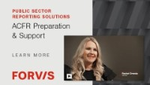

Slide 55


Slide 56
10-minute break

Slide 57
Effective Internal Controls for Agencies with Limited Resources
Jeff McCall / May 23, 2023

Slide 58

Meet the Presenter
Member of the Risk Advisory services internal audit practice
21 years of internal audit management and continuous improvement experience, including 18 years of leading internal audit functions in the energy and healthcare software industries
Spent 12 years in the assurance practice for an international accounting firm
Certified Internal Auditor (CIA) and Certified Public Accountant (CPA)
Member of the Institute of Internal Auditors (IIA) and the American Institute of CPAs (AICPA)
Jeff McCall, CIA, CPA
Senior Managing Consultant /
Internal Audit

Slide 59
Internal Control Definition and Why They are Important
A Lesson Regarding Internal Controls
Internal Control Framework and Key Considerations
What Can You Evaluate Now / Actions to Take
Practical Examples of Control Monitoring
Key Takeaways and Next Steps

Slide 60
Internal Control Definition and Why They Are Important

Slide 61
Internal Controls – What Are They?
Internal control is:
  a process
  effected by an entity’s board of directors, management and other personnel,
  Designed to provide reasonable assurance regarding the achievement of objectives relating to
    operations
    reporting and
    compliance
* Definition per the Internal Control – Integrated Framework (Committee of Sponsoring Organizations of the Treadway Commission (COSO))

Slide 62




Why Internal Controls are Important
Safeguard assets
Facilitate accurate and complete financial records
Promote operational efficiency
Advocate adherence to policies and regulations
Internal Controls are “everyone’s business”
Not just the responsibility of Finance, Accounting or Internal Audit

Slide 63
Inadequate or Non-Existent Controls Can Lead To
Loss or theft of assets
Inaccurate financial information
Excessive cost within the organization
Opportunities for fraud, waste and abuse
Non-compliance with laws or regulations

Slide 64
A Lesson Regarding Internal Controls

Slide 65
The Value of Internal Controls – Trust by Verify!
10/80/10 Rule
  Based on fraud presentation from former FBI Special Agent (for organizations in general), his professional judgement concluded:
    10% of employees would never steal
    10% of employees will likely steal at some point in time
    80% of employees may or may not steal, depending on the situation they are in
Good people can make bad decisions
Proper control environment/procedures foster good decisions

Slide 66
The 80% - What Can Happen
Female All-American athlete and student
Came from strong supportive family
Career started with small growing company - she worked very hard
1st theft - not initially intended (failed to reimburse employer for personal flight )
Based on personal budget at home being tight around holidays, it perpetuated into various cases of theft in which she would say “I will only do this one more time.”
She ended up stealing more than $500,000 over four years
Her world came crumbling down after guilt got to her / turned herself in
She went to prison for 18 months (5 weeks after giving birth)
As she took her first steps into federal prison, she looked through the glass panels in prison hallway and saw her parents crying as they held her baby
At that time, she realized she not only hurt herself and her employer but also her family

Slide 67
Internal Control Framework and Key Considerations

Slide 68
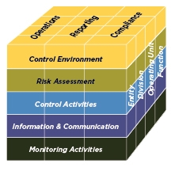
Internal Control Framework (COSO) *
Widely accepted internal control framework
Can be applied by entities of all sizes
Internal control categories
  Control Environment
  Risk Assessment
  Control Activities
  Information & Communication
  Monitoring Activities
* Internal Control – Integrated Framework (Committee of Sponsoring Organizations of the Treadway Commission (COSO))

Slide 69
Internal Control Maturity Scale
Where is your organization currently?
Ad-Hoc
Not Accountable
Defined
Managed
Optimized
Control structure not defined / random occurrence
Controls exist but lack documentation / adequacy / consistency
Control structure documented / standardized / integrated
Control process is regularly measured, assessed and tested
Continuous process improvement / focused on mitigating risk
Lack of Control
Best In Class

Slide 70
Key Aspects of Internal Controls to Consider
Preventive / detective
Segregation of duties
User access to key IT systems
In-person / remote workforce
Governance structure

Slide 71
Challenges or limitations of internal controls
Lack of enough resources for adequate segregation of duties
Lack of adequate funds and/or resources to automate processes
Manual processes prone to error
Opportunity for management override
Data integrity – “garbage in / garbage out”
Having limited resources does not mean you have to give up control
Rather, work to establish different types of control

Slide 72
What Can You Evaluate Now / Actions To Take

Slide 73
What Can You Do – Given Where You Are At?
Focus on areas of more significant risk
Leverage resources you have
Integrate procedures into your existing routines
Enhance management review procedures
Employ data analytic tools
Utilize internal audit resources, if available
Enhance governance structure / formalize policies and procedures
Strive for continuous improvement

Slide 74

Focus on Areas with Most Significant Risk
Assess risk within your organization
What is risk?
  The possibility that events will occur and affect the achievement of strategy and business objectives
Examples of areas with more significant risk
  Cash disbursement processes (accounts payable, ACH, Wires)
  Cash receipt processes
  Period end close / financial reporting processes
  User security access to key IT systems
  Cybersecurity risk

Slide 75
Ways to Assess Risk within Your Organization
Develop an initial population of risks common to most organizations
Options to perform risk assessment
  Internal self-assessment
    Perform centralized assessment by individuals with institutional knowledge
    Utilize electronic surveys to gather input from leaders across the organization
  External 3rd party assessment
  Internal and external risk assessment

Slide 76
Evaluate If Basic Blocking / Tackling Is In Place
Examples of timeless internal controls:
  Timely account reconciliations
  Proper journal entry approval process
  Secured access to key functions (i.e. – checks, electronic payments)
  Proper handling of cash receipts and deposits
  Defined limits of authority
Monitoring Controls are Key
Helps Mitigate Segregation of Duties Risk

Slide 77

Enhance Management Review Procedures
Reporting / Analysis / Reconciliations
  Ensure periodic follow-up questions are asked to all team members (especially remote workforce)
    Let everyone know “you are looking”
Invoices / Contracts
  “Pause before you sign” – Signatures without thought
  make it easy for those who are trying to fool you
Make “surprise” visits to remote locations
Be alert to your surroundings – managers are first line of defense

Slide 78

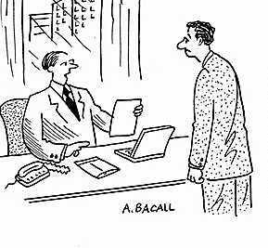
Other Tools to Utilize for Internal Control Monitoring
Reporting on key data / metrics
  Can include simple reporting in Excel
  More advanced reporting with data mining tools
Self-assessment surveys from process and control owners
Segregation of duties matrices
Confidential Helpline
Be creative →
“Your approach is creative. Unfortunately, we won’t be able to use it because we have never done something like this before.”

Slide 79
Practical Examples of Control Monitoring

Slide 80

Internal Control Monitoring – Practical Example
Cash disbursements
  Review physical and IT security access for:
    Vendor master file – access to add / make vendor changes
    Processing accounts payable checks
    Processing electronic disbursements (ACH’s, Wire Transfers)
      Use of Multi-Factor Authentication (MFA)
  Monitor patterns in data
    Duplicate payments
    High volume / low average $ invoices (below DOA levels)
      Example fraud – $1 million plus fraud with only 1 level of management approval

Slide 81
Internal Control Monitoring – Practical Example
Segregation of duties evaluation
Cash Disbursements
Category of Duties | Primary Activities / Sub-Processes | Who Performs Function | Mitigating Controls for Conflicting Duties
Authorization | 1. Initial | 1. Field management | No segregation of duties issues noted
 | 2. Secondary | 2. Corporate management
Custody of Assets | 1. Process check requests | 1. Accounts Payable | No segregation of duties issues noted
 | 2. Distribute checks | 2. Administrative staff
Recording | 1. Approve journal entries | 1. Controller | No segregation of duties issues noted
Control Activity (i.e. – reconciliation) | 1. Reconciles G/L to A/P subledger | 1. Accounting staff | No segregation of duties issues noted

Slide 82

Internal Control Monitoring – Practical Example
Critical
Value Add
Best in Class
Periodic user access reviews (UAR) of IT access security
  IT provides user data and related permissions
  Business owners of applications review and approve
  IT makes necessary corrections
Key elements of UAR’s
  Identify terminated employees that still have access
  Review for appropriateness of access based on
  employee’s position
  Review for segregation of duties based on overall
  job responsibilities

Slide 83
Internal Control Monitoring – Practical Example
UAR’s – Key systems / applications to review
  Network access (Active Directory)
  Accounts payable
  General ledger
  Treasury function (i.e. – wire transfers)
  HR – Employee master file
  Payroll processing
Other considerations
  Determine if any “back-doors” exist to applications (i.e. – able to access outside of organization’s network access, such as direct URL log-in to application’s hosted website)

Slide 84
Key Takeaways and Next Steps

Slide 85

Key Takeaways – What Can You Do Now
Build off what you have in place already
If lower on internal control maturity scale, start simple - “get some wins”
Automate when possible
Management oversight is CRITICAL
  Trust but verify
  Make sure your employees know you are interested and monitoring
Strive for continuous improvement; periodically self-assess
Internal Controls Are Not “One Size Fits All”
Tailor to Your Agency and Your Risks

Slide 86
Internal Control Maturity Scale
Take the time to assess current status
Ad-Hoc
Not Accountable
Defined
Managed
Optimized
Control structure not defined / random occurrence
Controls exist but lack documentation / adequacy / consistency
Control structure documented / standardized / integrated
Control process is regularly measured, assessed and tested
Continuous process improvement / focused on mitigating risk
Lack of Control
Best In Class

Slide 87
Questions?
Thank you!

Slide 88
Lunch

Slide 89
Emerging Fraud Risks
Lanny Morrow / May 23, 2023

Slide 90
Emerging Fraud Risks
Fake Documents
Altered Metadata
Destruction

Slide 91
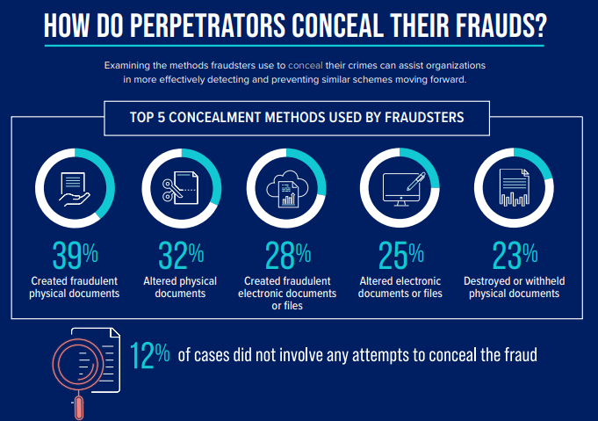
Evolving Concealment Tactics
New Category
in 2022
Source: Occupational Fraud 2022: A Report to the Nations”. https://acfepublic.s3.us-west-2.amazonaws.com/2022-RTTN-How-Do-Perpetrators-Conceal-Their-Frauds.pdf

Slide 92
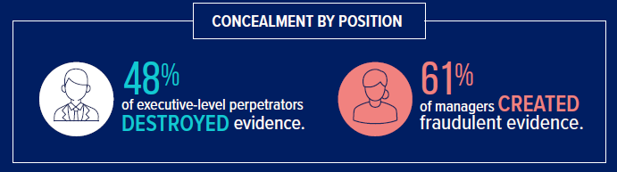
Evolving Concealment Tactics
“Destruction” includes mass deletions from network or PC, wiping of hard drives or phone memory, shredding documents, and deleting emails.
Source: Occupational Fraud 2022: A Report to the Nations”. https://acfepublic.s3.us-west-2.amazonaws.com/2022-RTTN-How-Do-Perpetrators-Conceal-Their-Frauds.pdf

Slide 93
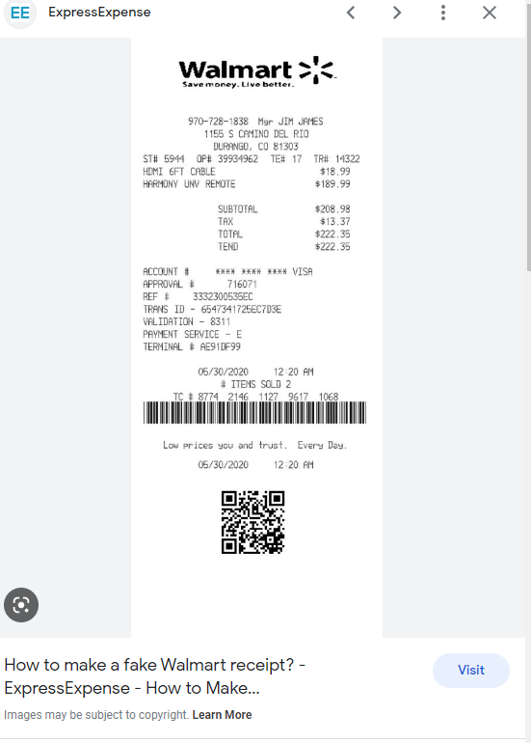
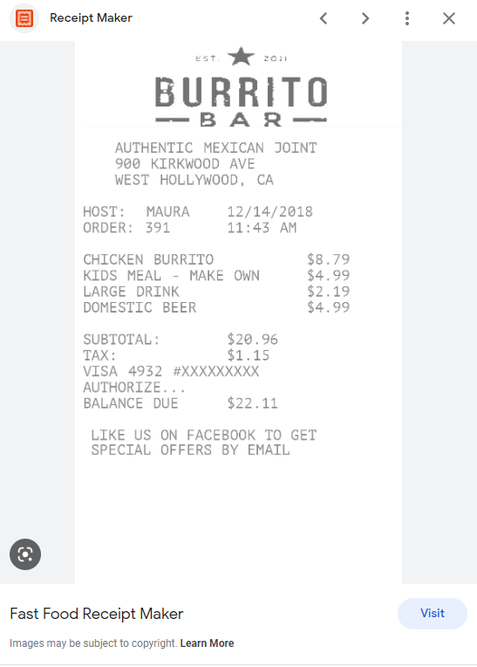
Fake Receipts
Free online fake receipt and invoice sites exploded in 2020 and have not diminished.

Slide 94
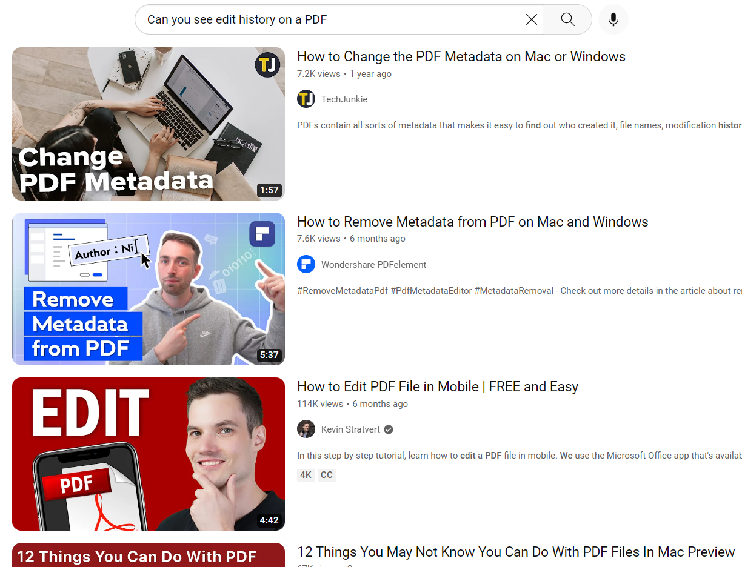
PDF Metadata
2022 witnessed a surge in harder-to-detect PDF invoice fakes.
Correlates with increasing savvy by fraudsters.

Slide 95
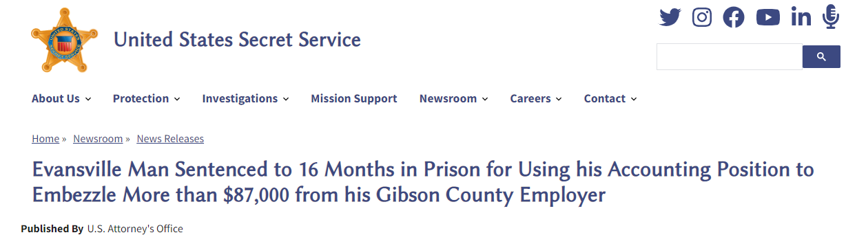
Evolving Concealment Tactics
Direct bill and fake invoice scheme
“Garrett entered false or altered information about these purchases into his employer’s accounting system to conceal the fraud.”
One car, five motorcycles, three electronic scooters, Apple iPad Pro, Apple MacBook, two drones

Slide 96
Hackers and Employees

Slide 97

Evolving Hacker and Employee Tactics
“Executive Footprinting” and “Employee Footprinting”
Collusion with employees
  Wire transfer fraud
  Ransomware
  Contact works in both directions
Physical entry (adapting tactic)
Employees – Theft of Intellectual Property

Slide 98
Managing Risk
Continuous Monitoring
Behavioral Red Flags
Digital Breadcrumbs

Slide 99
Continuous Monitoring
Continuous monitoring – Continuous (all the time) monitoring of processes, transactions, policies, etc. to identify deviations from normal, patterns, and risk conditions. Primarily a detection concept.
Continuous auditing – Continuous gathering and analysis of data to support internal audit functions. Primarily an efficiency concept.
Automation – Making continuous procedures automatic and in near real-time with little effort on the auditor’s part.
Technologies – Tools and tech to automate, visualize, and alert.

Slide 100
Continuous Monitoring Areas
Transactions Monitoring – Identifying transactions that pose a potential risk of fraud, overpayment, illegal, regulatory violations, duplicate payment, etc.
Adherence to Policy – Segregation of duties violations such as setting up a vendor, approving payment, and processing payment. Operational policies, etc.
IT Security – Detection of employees with unintentional unauthorized access.
Cybersecurity – Password sharing, weak passwords, risky computer behavior.
Reputation
Conflicts of Interest – Bidding process, undisclosed relationships, corruption.
Other – Operations, safety, governance, legal…

Slide 101
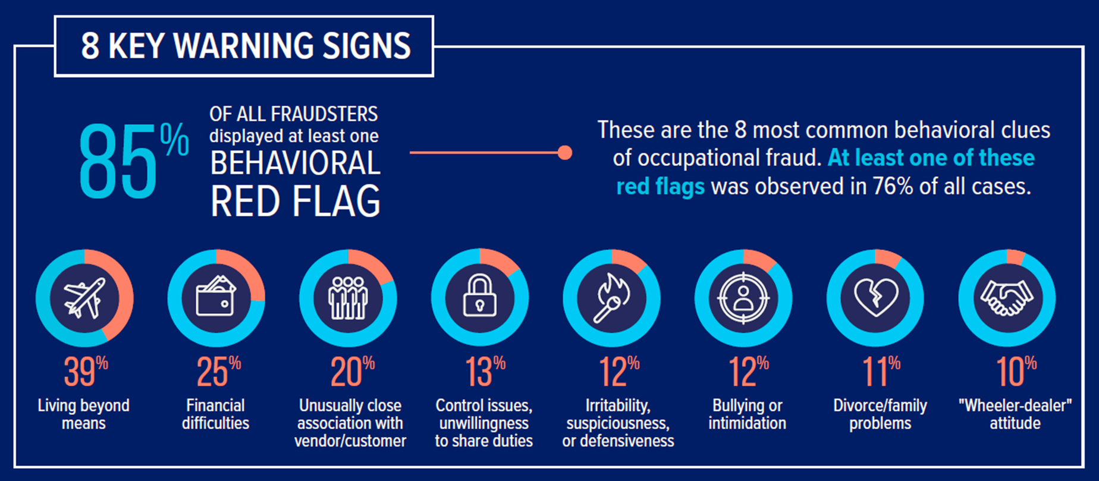
Behavioral Red Flags
Source: Occupational Fraud 2022: A Report to the Nations”. https://acfepublic.s3.us-west-2.amazonaws.com/2022-RTTN-How-Do-Perpetrators-Conceal-Their-Frauds.pdf

Slide 102
Digital Evidence
PC’s have a treasure trove of data
  Recovery of deleted files
  Internet history and website visits
  User timeline and history
  Remote logins
Preservation during an “incident”
  PC, phone, email account, and network share
  Firewall logs, VPN or remote access logs, email environment
  Capture social media or other relevant internet data

Slide 103
Digital Evidence – Findings in Real Life
Creation of fake invoices directly on system
Emailing fake invoices from home to work
Deletion of fake/altered content
Accessing personal bank account to verify wire transfer
Establishing a fake domain using work PC
Google searches for altering or faking documents
Personal communications captured on work PC
Document uploads, email attachments

Slide 104
Recommendations

Slide 105
Action Items
Proactively look for fraud and risk
Continuous monitoring for fraud and risk (automation and alerts)
Watch for behavioral red flags
Practice audit by walking around, and its digital equivalent
Get a hotline, tell everyone. Remind them frequently.
Consider digital evidence when investigating potential fraud.
Cybersecurity – Consider insider risk; continue to educate.

Slide 106
Thank You!
Lanny Morrow
816.284.1080
Lanny.Morrow@forvis.com

Slide 107
Switch Rooms

