Slide 1
Economic Update & Market Outlook
August 30, 2023

Slide 2



Meet the Presenters
Katie Jaskinia
Senior Managing Advisor
Matt Wahl
Managing Director
Stephanie Hurt
Director

Slide 3
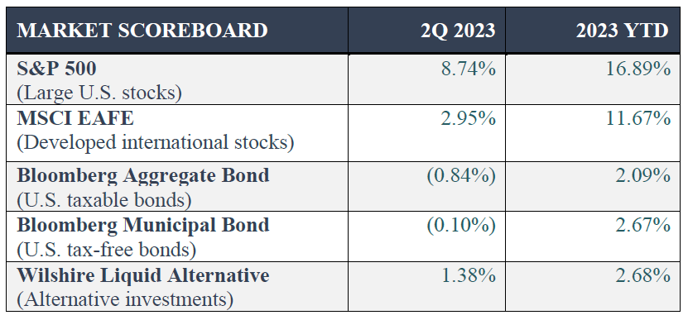
Market Scoreboard
Source: Morningstar Inc, Tamarac Advisor View as of June 30, 2023.

Slide 4
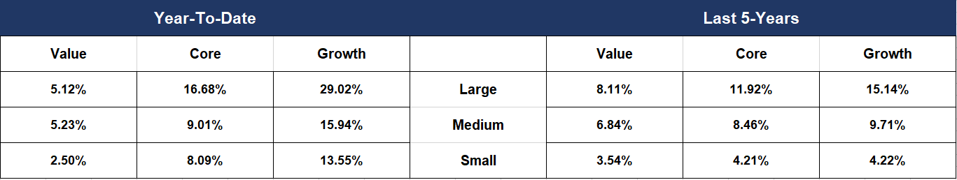
U.S. Stock Returns – Value vs. Growth
Source: Morningstar Office. Large, medium, and small are represented by the Russell 1000 Index, Russell Mid-Cap Index, and the Russell 2000 Index, respectively. Data as of June 30, 2023.

Slide 5
S&P 500: Concentration, Valuations and Earnings
Source: FactSet, Standard & Poor’s, J.P. Morgan Asset Management. The top 10 S&P 500 companies are based on the 10 largest index constituents at the beginning of each month. As of 6/30/2023, the top 10 companies in the index were AAPL (7.7%), MSFT (6.8%), AMZN (3.1%), NVDA (2.8%), GOOGL (1.9%), TSLA (1.9%), Meta (1.7%), GOOG (1.7%), BRK.B (1.6%), UNH (1.2%) and XOM (1.2%). The remaining stocks represent the rest of the 494 companies in the S&P 500. Data are as of June 30, 2023.

Slide 6
Bloomberg U.S. Agg. Annual returns and Intra-Year Declines
Source: Bloomberg, FactSet, J.P. Morgan Asset Management. Returns are based on total return. Intra-year drops refers to the largest market drops from a peak to a trough during the year. For illustrative purposes only. Returns shown are calendar year returns from 1976 to 2022, over which time period the average annual return was 6.6%. Returns from 1976 to 1989 are calculated on a monthly basis; daily data are used afterwards. Data as of December 31, 2022.

Slide 7
Recession Determinants
Source: Bureau of Economic Analysis, Bureau of Labor Statistics, Census Bureau, Federal Reserve of St. Louis, NBER, J.P. Morgan Asset Management. Heatmap shading reflects 10 years of data, with green and red reflecting a range of +/- 0.5 standard deviations from a baseline of 0% monthly growth. *The NBER’s definition of a recession involves a significant decline in economic activity that is spread across the economy and lasts more than a few months. Because a recession must influence the economy broadly and not be confined to one sector, the committee emphasizes economy-wide measures of economic activity. Specifically, they consider real personal income less transfers, nonfarm payroll employment, employment as measured by the household survey, real personal consumption expenditures, wholesale-retail sales adjusted for price changes and industrial production. There is no fixed rule about what measures contribute to the process or how they are weighted, but the committee notes that “in recent decades, the two measures we have put the most weight on are real personal income less transfers and nonfarm payroll employment.” Data as of June 30, 2023.

Slide 8
Economic Growth and the Composition of GDP
Source: BEA, FactSet, J.P. Morgan Asset Management. Values may not sum to 100% due to rounding. Trend growth is measured as the average annual growth rate from business cycle peak 1Q01 to business cycle peak 4Q19. Data are as of June 30, 2023.

Slide 9
Consumer Finances
Source: FactSet, FRB, J.P. Morgan Asset Management; (Top and bottom right) BEA. Data include households and nonprofit organizations. SA – seasonally adjusted. *Revolving includes credit cards. Values may not sum to 100% due to rounding. **2Q23 figures for debt service ratio are J.P. Morgan Asset Management estimates. Data are as of June 30, 2023.

Slide 10
Consumer Saving and Borrowing
Source: BEA, Federal Reserve, J.P. Morgan Asset Management. From March 2020 to August 2021, consumers amassed a peak $2.1 trillion in excess savings relative to the pre-pandemic trend. Since August 2021, consumers have drawn down on those excess savings, with the remaining reflected in the chart annotation. Data are as of June 30, 2023.

Slide 11
Unemployment and Wages
Source: BLS, FactSet, J.P. Morgan Asset Management. Private production and non-supervisory jobs represent just over 80% of total private nonfarm jobs. Data are as of June 30, 2023.

Slide 12
Inflation
Source: BLS, FactSet, J.P. Morgan Asset Management. CPI used is CPI-U and values shown are % change vs. one year ago. Core CPI is defined as CPI excluding food and energy prices. The Personal Consumption Expenditure (PCE) deflator employs an evolving chain-weighted basket of consumer expenditures instead of the fixed-weight basket used in CPI calculations. Data are as of June 30, 2023.

Slide 13
Inflation Compenents
Source: Bureau of Labor Statistics, FactSet, J.P. Morgan Asset Management. Contributions mirror the BLS methodology on Table 7 of the CPI report. Values may not sum to headline CPI figures due to rounding and underlying calculations. *Core services ex-shelter CPI is a custom index using CPI components created by J.P. Morgan Asset Management. Left: “Shelter” includes owners’ equivalent rent and rent of primary residence; “Other” primarily reflects household furnishings, apparel, education and communication services, medical care services and other personal services. Right: “Transportation services” primarily includes leased cars and trucks, motor vehicle insurance and motor vehicle maintenance and repair. Airline fares are broken out from transportation services. Data are as of June 30, 2023.

Slide 14
The Fed and Interest Rates
Source: Bloomberg, FactSet, Federal Reserve, J.P. Morgan Asset Management. Market expectations are based off of the respective Federal Funds Futures contracts for December expiry. *Long-run projections are the rates of growth, unemployment and inflation to which a policymaker expects the economy to converge over the next five to six years in absence of further shocks and under appropriate monetary policy. Forecasts are not a reliable indicator of future performance. Forecasts, projections and other forward-looking statements are based upon current beliefs and expectations. They are for illustrative purposes only and serve as an indication of what may occur. Given the inherent uncertainties and risks associated with forecasts, projections or other forward-looking statements, actual events, results or performance may differ materially from those reflected or contemplated. Data as of June 30, 2023.

Slide 15
Yield Curve
Source: FactSet, Federal Reserve, J.P. Morgan Asset Management. Data as of June 30, 2023.

Slide 16
CD Rates and Other Investment Opportunities
Source: Bankrate, Bloomberg, FactSet, Federal Reserve, Robert Shiller, J.P. Morgan Asset Management. U.S. High Yield: Bloomberg U.S. Corporate High Yield Index. The S&P 500 total return figure from the 1984 period was calculated using data from Robert Shiller. The analysis references the month in which the 6-month average CD rate peaked during previous rate hiking cycles. CD rate data prior to 2013 are sourced from the Federal Reserve whereas data from 2013 to 2023 are sourced from Bankrate. CD subsequent 12-month return calculation assumes reinvestment at the prevailing 6-month rate when the initial CD matures. U.S. High Yield performance does not appear for the 2019 period because returns were flat at 0.03%. Data are as of June 30, 2023.

Slide 17
Fixed Income Valuations
Source: Bloomberg, FactSet, J.P. Morgan Credit Research, J.P. Morgan Asset Management. Indices used are Bloomberg except for emerging market debt and leveraged loans: EMD (USD): J.P. Morgan EMIGLOBAL Diversified Index; EMD (LCL): J.P. Morgan GBI-EM Global Diversified Index; EM Corp.: J.P. Morgan CEMBI Broad Diversified; Leveraged Loans: JPM Leveraged Loan Index; Euro IG: Bloomberg Euro Aggregate Corporate Index; Euro HY: Bloomberg Pan-European High Yield Index. Yield-to-worst is the lowest possible yield that can be received on a bond apart from the company defaulting. All sectors shown are yield-to-worst except for Municipals, which is based on the tax-equivalent yield-to-worst assuming a top-income tax bracket rate of 37% plus a Medicare tax rate of 3.8%. Data are as of June 30, 2023.
.

Slide 18
Equity Scenarios: Bull, Bear and In-Between
Source: FactSet, NBER, Robert Shiller, Standard & Poor’s, J.P. Morgan Asset Management. (Left) The current peak of 4797 was observed on January 3, 2022. (Right) *A bear market is defined as a 20% or more decline from the previous market high. The related market return is the peak to trough return over the cycle. Bear and bull returns are price returns. **The bear market beginning in January 2022 is currently ongoing. The “bear return” for this period is from the January 2022 market peak through the current trough. Averages for the bear market return and duration do not include figures from the current cycle. Data as of June 30, 2023.

Slide 19
S&P 500 Valuation Measures
Source: FactSet, FRB, Refinitiv Datastream, Robert Shiller, Standard & Poor’s, Thomson Reuters, J.P. Morgan Asset Management. Price-to-earnings is price divided by consensus analyst estimates of earnings per share for the next 12 months as provided by IBES since June 1998 and by FactSet since January 2022. Current next 12-months consensus earnings estimates are $233. Average P/E and standard deviations are calculated using 25 years of history. Shiller’s P/E uses trailing 10-years of inflation-adjusted earnings as reported by companies. Dividend yield is calculated as the next 12-months consensus dividend divided by most recent price. Price-to-book ratio is the price divided by book value per share. Price-to-cash flow is price divided by NTM cash flow. EY minus Baa yield is the forward earnings yield (consensus analyst estimates of EPS over the next 12 months divided by price) minus the Moody’s Baa seasoned corporate bond yield. Std. dev. over-/under-valued is calculated using the average and standard deviation over 25 years for each measure. *P/CF is a 20-year average due to cash flow availability. Data are as of June 30, 2023.
.

Slide 20
P/E Ratios and Equity Returns
Source: FactSet, Refinitiv Datastream, Standard & Poor’s, Thomson Reuters, J.P. Morgan Asset Management. Returns are 12-month and 60-month annualized total returns, measured monthly, beginning 5/31/1998. R² represents the percent of total variation in total returns that can be explained by forward price-to-earnings ratios. Price-to-earnings is price divided by consensus analyst estimates of earnings per share for the next 12 months as provided by IBES since February 1998 and by FactSet since January 2022. Data are as of June 30, 2023.
.

Slide 21
Cycles of U.S. Equity Outperformance
Source: FactSet, MSCI, J.P. Morgan Asset Management. Regime change determined when cumulative outperformance peaks and is not reached again in the subsequent 12-month period. Data are as of June 30, 2023.
.

Slide 22
International Valuations and Dividend Yields
Source: FactSet, MSCI, Standard & Poor's, J.P. Morgan Asset Management. Data as of June 30, 2023.
.

Slide 23
Annual returns and Intra-Year Declines
Source: FactSet, Standard & Poor’s, J.P. Morgan Asset Management. Returns are based on price index only and do not include dividends. Intra-year drops refers to the largest market drops from a peak to a trough during the year. For illustrative purposes only. Returns shown are calendar year returns from 1980 to 2022, over which time period the average annual return was 8.7%. Data are as of June 30, 2023.

Slide 24
Impact of Being Out of the Market
Source: J.P. Morgan Asset Management analysis using data from Bloomberg. Returns are based on the S&P 500 Total Return Index, an unmanaged, capitalization-weighted index that measures the performance of 500 large capitalization domestic stocks representing all major industries. Indices do not include fees or operating expenses and are not available for actual investment. The hypothetical performance calculations are shown for illustrative purposes only and are not meant to be representative of actual results while investing over the time periods shown. The hypothetical performance calculations for the respective strategies are shown gross of fees. If fees were included, returns would be lower. Hypothetical performance returns reflect the reinvestment of all dividends. The hypothetical performance results have certain inherent limitations. Unlike an actual performance record, they do not reflect actual trading, liquidity constraints, fees and other costs. Also, since the trades have not actually been executed, the results may have under- or overcompensated for the impact of certain market factors such as lack of liquidity. Simulated trading programs in general are also subject to the fact that they are designed with the benefit of hindsight. Returns will fluctuate and an investment upon redemption may be worth more or less than its original value. Past performance is not indicative of future returns. An individual cannot invest directly in an index. Data as of December 31, 2022.

Slide 25
Asset Class Returns
Source: Bloomberg, FactSet, MSCI, NAREIT, Russell, Standard & Poor’s, J.P. Morgan Asset Management. Large cap: S&P 500, Small cap: Russell 2000, EM Equity: MSCI EME, DM Equity: MSCI EAFE, Comdty: Bloomberg Commodity Index, High Yield: Bloomberg Global HY Index, Fixed Income: Bloomberg US Aggregate, REITs: NAREIT Equity REIT Index, Cash: Bloomberg 1-3m Treasury. The “Asset Allocation” portfolio assumes the following weights: 25% in the S&P 500, 10% in the Russell 2000, 15% in the MSCI EAFE, 5% in the MSCI EME, 25% in the Bloomberg US Aggregate, 5% in the Bloomberg 1-3m Treasury, 5% in the Bloomberg Global High Yield Index, 5% in the Bloomberg Commodity Index and 5% in the NAREIT Equity REIT Index. Balanced portfolio assumes annual rebalancing. Annualized (Ann.) return and volatility (Vol.) represents period from 12/31/2007 to 12/31/2022. Please see disclosure page at end for index definitions. All data represents total return for stated period. The “Asset Allocation” portfolio is for illustrative purposes only. Past performance is not indicative of future returns. Data are as of June 30, 2023.

Slide 26
Questions?

Slide 27
Thank You!

